Slide 1
Design Masterclass Bandai Namco Brief Group 2
George Flude, Alex Polley and Callum Walsh

Slide 2
Audience

Slide 3
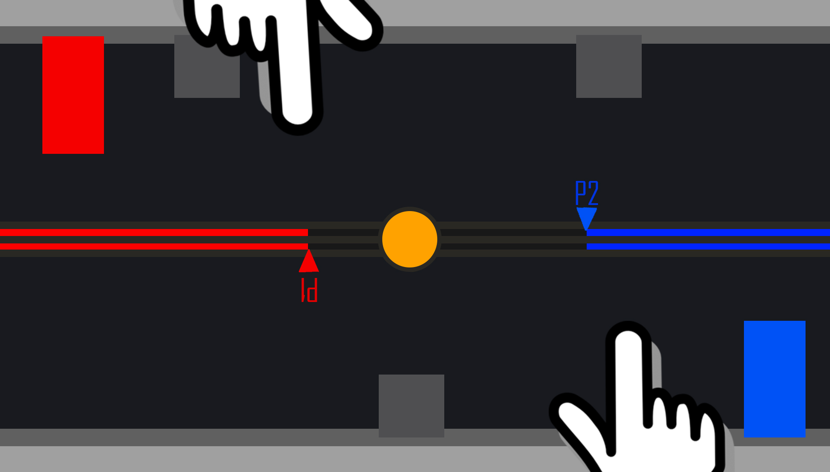
Concept 1 -

Slide 4
Inspiration

Slide 5
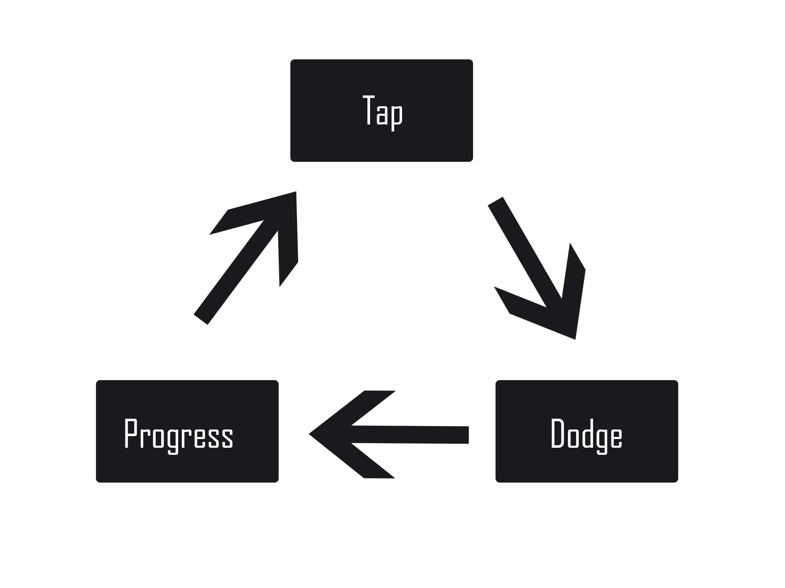
Challenges
Insert Text
Insert more Text
Insert morer Text

Slide 6
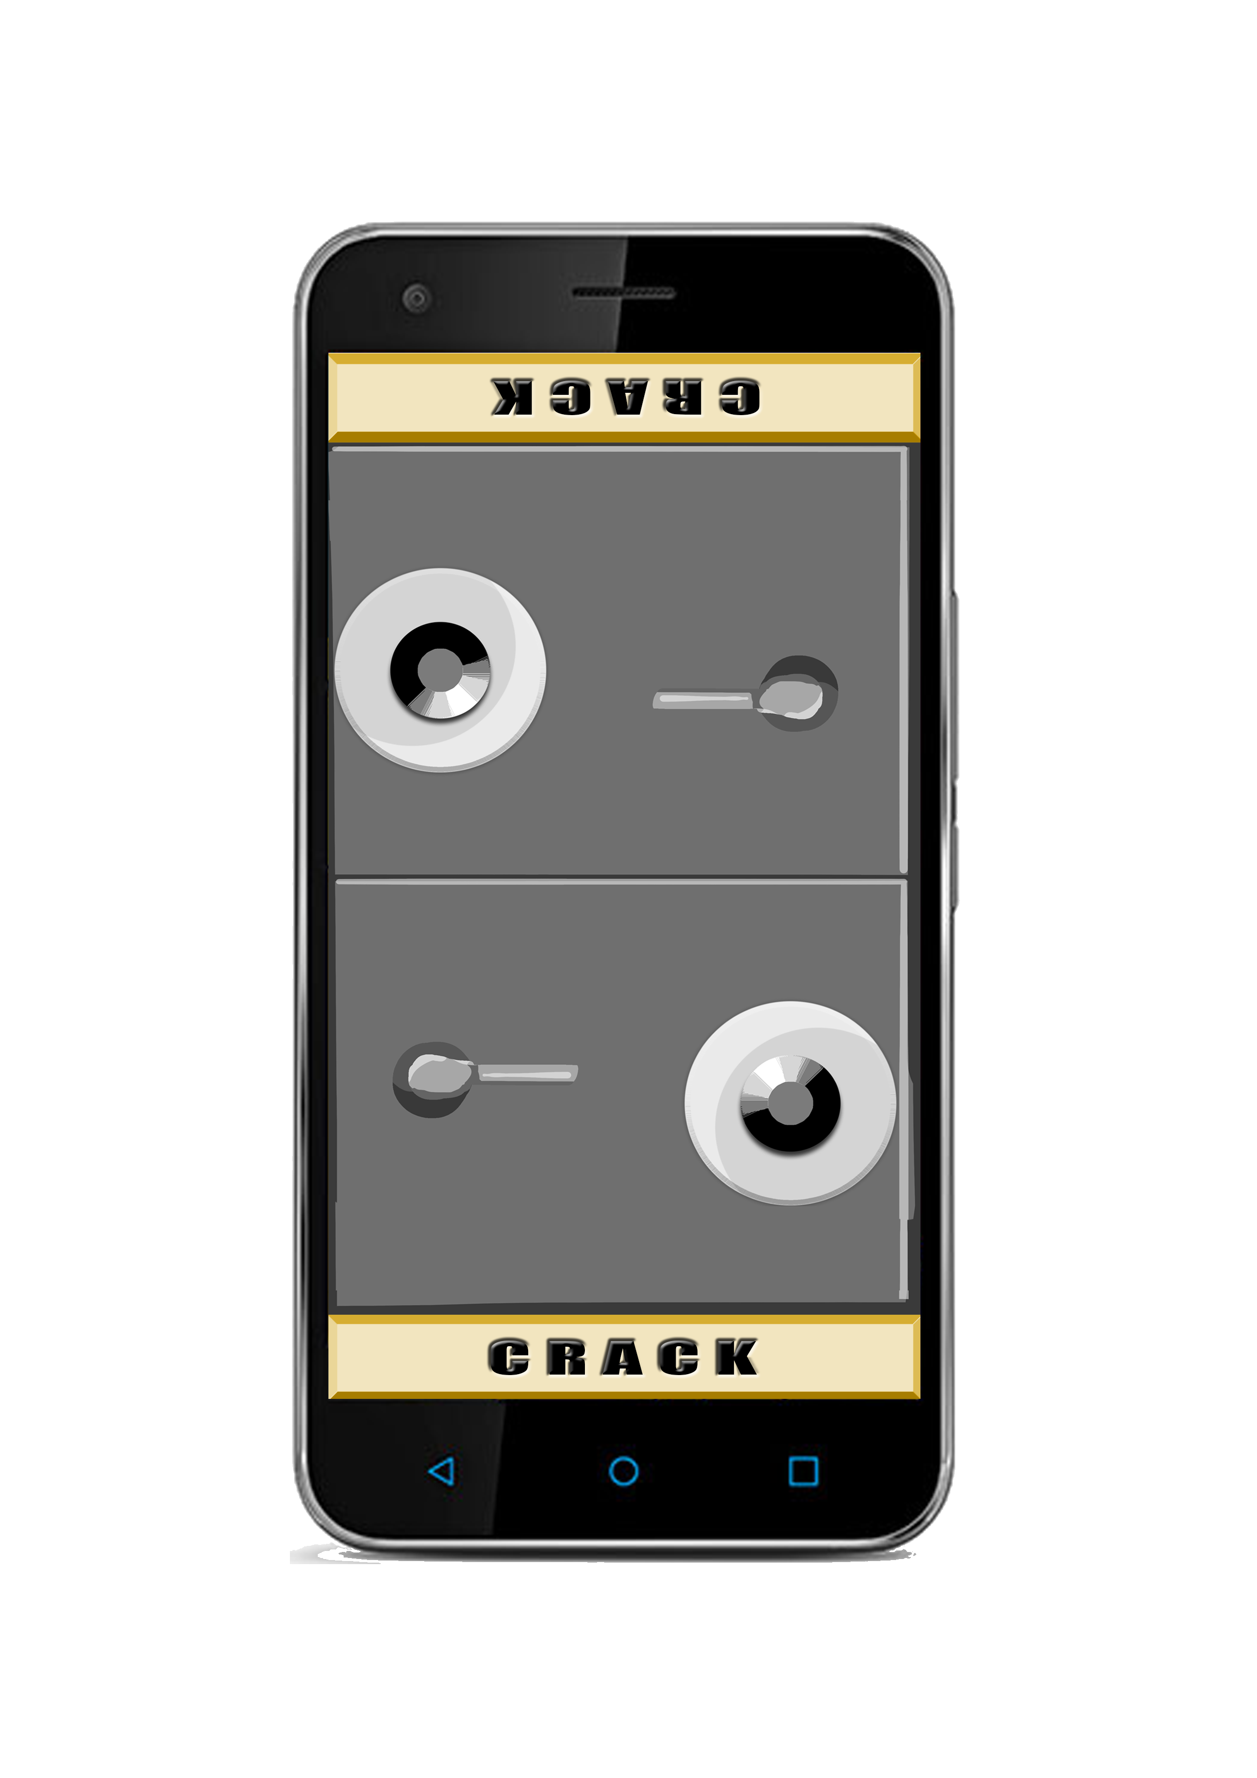
Concept 2 -

Slide 7
Inspiration

Slide 8
Challenge

Slide 9
Concept 3 -

Slide 10
Inspiration

Slide 11
Challenge

